Slide 1
Weekly Update
Jorian Bruslind
Week 9

Slide 2
HyperRail Project
Current Status
Updated Y-axis now moves freely over the upper 8020 beam
Problems with the belt continuity (slipping over static belt)
Tensioning needs to be tuned to determine optimal stress
3D printed shroud for motor node + stepper mode
Oscillations in the gantry due to lack of surface area contact
Looking to increase carriage length and add additional supports
Researching Tuned Mass Dampers to minmize vibration on the upper carriage

Slide 3
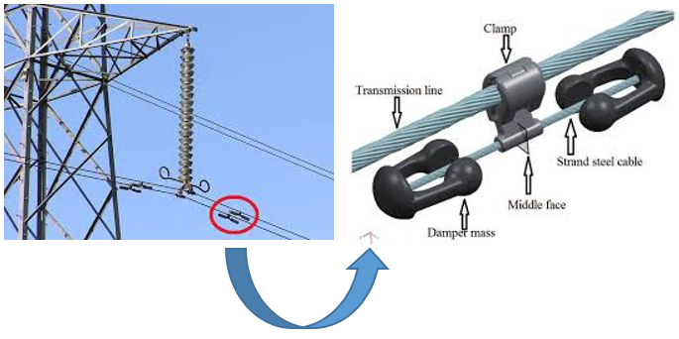
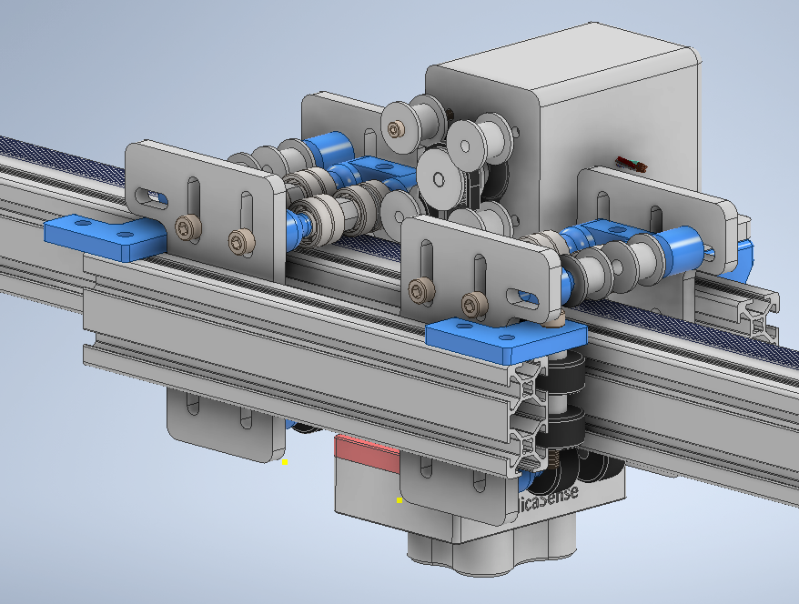
Current Status

Slide 4
Project Work
Meeting with CS capstone team regularly about requirements and work
Have a rough draft for the user interface and a wire diagram showing connections
User will be able to define “image area” and the program will determine images
Looking for finalized components for upper belt
Thickness and tension becoming an issue
Homing sequence and encoder needs to be implemented
Finally have prototype with motion, can implement homing

Slide 5
Next Steps
Register for classes next term (ECE 576 vs ECE 599 (CPS)
Test homing feature along with motion repeatability
Add wiring harnesses into frame
Finish testing speed with automated tests
Order finalized components (made from CNC aluminum, not PLA/PETG)

